Slide 1

Sprocket Central Pty Ltd
Data analytics approach
By Roshankumar S

Slide 2
Agenda
Introduction
Data Exploration
Model Development
Interpretation

Slide 3

Introduction
Importance of Data Analysis
Data analysis plays a crucial role in extracting meaningful insights from raw data, enabling organizations to make informed decisions and drive business success. It allows businesses to understand patterns, trends, and relationships within their data, which can uncover opportunities, identify potential risks, and optimize processes. Data analysis helps in understanding customer behavior, improving product offerings, enhancing operational efficiency, and gaining a competitive edge in the market.

Slide 4

Introduction
Role of Data Analysis in Decision-Making
Data analysis is instrumental in the decision-making process as it provides evidence-based insights and supports data-driven decision-making. By analyzing data, organizations can evaluate different options, assess their potential outcomes, and make informed choices. Data analysis helps in identifying trends, patterns, and correlations, enabling decision-makers to understand the impact of their choices and make strategic decisions aligned with organizational goals. It minimizes the reliance on intuition or guesswork and promotes objective decision-making based on empirical evidence.

Slide 5
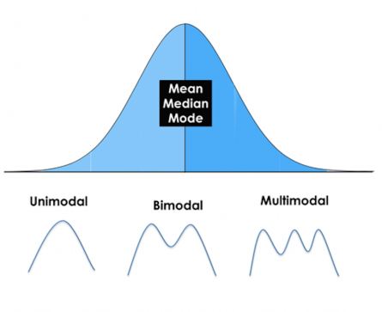
Data Exploration
Descriptive Statistics and Summary Measures
Descriptive statistics involve summarizing and describing the main characteristics of a dataset. It provides a quantitative summary of the data and helps in understanding its central tendency, variability, and distribution. Descriptive statistics include measures such as mean, median, mode, standard deviation, range, and percentiles. These measures provide insights into the average value, dispersion, and shape of the data, enabling researchers to gain a better understanding of the dataset's overall properties.

Slide 6
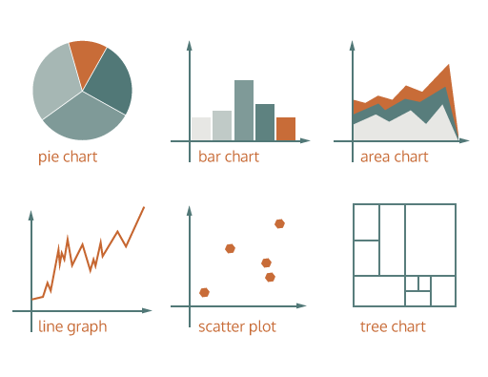
Data Exploration
Data Visualization Techniques
Data visualization techniques involve representing data visually using charts, graphs, and plots. Data visualization helps in presenting complex information in a visually appealing and easily understandable manner. It allows analysts to explore patterns, relationships, and trends in the data, facilitating better comprehension and interpretation. Common data visualization techniques include bar charts, line graphs, scatter plots, histograms, heatmaps, and box plots. By visualizing the data, analysts can identify patterns, outliers, clusters, and other key characteristics that may not be evident in raw data.

Slide 7
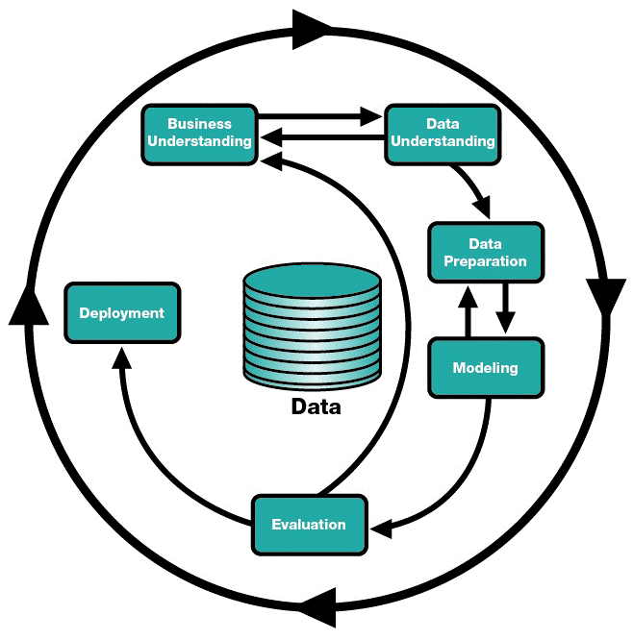
Data Exploration
Identifying Patterns, Trends, and Outliers
Data analysis aims to uncover patterns, trends, and outliers in the dataset. Patterns refer to recurring structures or relationships within the data. Trends indicate the direction and magnitude of change over time or across variables. Outliers are data points that deviate significantly from the expected or typical values. Identifying patterns, trends, and outliers can provide valuable insights into the underlying processes, relationships, and anomalies within the data. Statistical techniques such as regression analysis, time series analysis, and cluster analysis can be applied to identify and analyze these patterns, trends, and outliers, assisting in decision-making and further analysis.

Slide 8
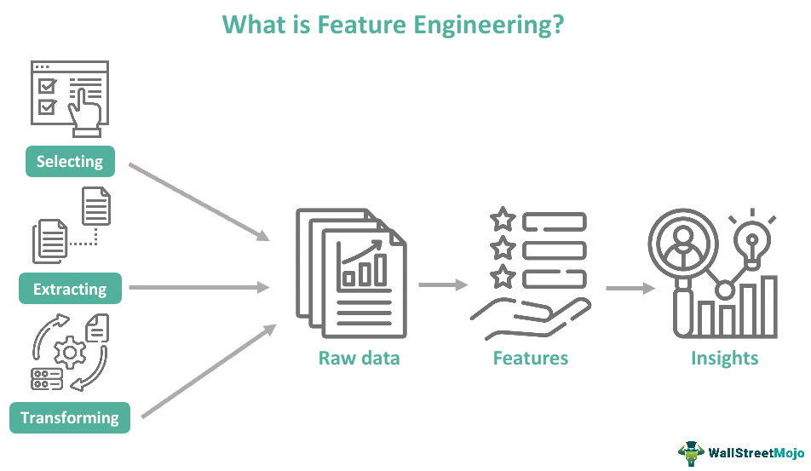
Model Development
Data preparation and feature engineering
Data preparation involves cleaning and preprocessing the data, handling missing values, outliers, and formatting issues to ensure the data's accuracy and consistency. Feature engineering focuses on creating new features or modifying existing ones to capture more meaningful information from the data. This can include encoding categorical variables, selecting relevant features, and transforming variables to improve model performance. These steps play a vital role in improving the quality of the dataset, reducing dimensionality, and enhancing the predictive power of models by extracting relevant patterns and relationships from the data.

Slide 9
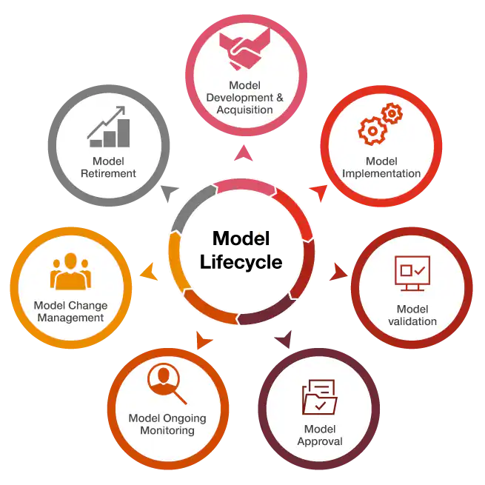
Model Development
Train the model
Model training is a critical step in the model development process where the selected model is trained on a labeled dataset to learn patterns, relationships, and dependencies in the data. During training, the model adjusts its internal parameters based on the input data and the corresponding target variables. The objective is to minimize the difference between the model's predictions and the true values. This process involves iterative optimization algorithms, such as gradient descent, to update the model's parameters and improve its performance. Model training is essential in enabling the model to capture the underlying patterns in the data and make accurate predictions or classifications when applied to new, unseen data.

Slide 10
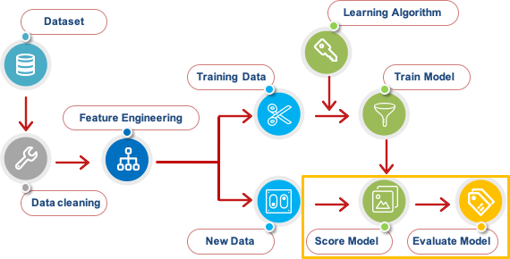
Model Development
Model Evaluation
Model evaluation is a critical step in the model development process that assesses the performance and effectiveness of the trained model. It involves measuring how well the model generalizes to unseen data and how accurately it predicts or classifies the target variable. Various evaluation metrics, such as accuracy, precision, recall, F1 score, and area under the curve (AUC), are used to quantify the model's performance. Additionally, techniques like cross-validation and holdout validation are employed to assess the model's robustness and ability to handle different datasets. Model evaluation provides insights into the model's strengths, weaknesses, and its suitability for the intended application, helping stakeholders make informed decisions based on its performance characteristics.

Slide 11
Interpretation
Interpretation is a crucial aspect of data analysis and model development that aims to understand and explain the insights and findings derived from the data and models. It involves extracting meaningful and actionable information from the analysis results and communicating it in a comprehensible manner to stakeholders. Interpretation encompasses understanding the relationships between variables, identifying important features and their impact on the model's predictions, and providing context to the results based on domain knowledge. It helps in uncovering patterns, trends, and relationships in the data, making informed decisions, and gaining valuable insights for problem-solving and decision-making processes. Effective interpretation bridges the gap between complex data analysis and practical applications, enabling stakeholders to grasp the implications and make well-informed decisions based on the analysis outcomes.

